Slide 1
Programming
Preparation

Slide 2
Java script
Fundamentals
Advanced

Slide 3
intro
JavaScript is the world's most popular programming language.
JavaScript is the programming language of the Web.
JavaScript is easy to learn.
JavaScript is one of the 3 languages all web developers must learn:
HTML to define the content of web pages
CSS to specify the layout of web pages
JavaScript to program the behavior of web pages

Slide 4
Data types and variables
The concept of data types
Examples
In programming, data types is an important concept.
To be able to operate on variables, it is important to know something about the type.
Without data types, a computer cannot safely solve this …
let x = 16 + "Volvo";
When adding a number and a string, JavaScript will treat the number as a string.
let x = 16 + "Volvo";
JavaScript evaluates expressions from left to right. Different sequences can produce different results:

Slide 5
Data types and variables
let x = 16 + 4 + "Volvo";
//20Volvo
let x = "Volvo" + 16 + 4;
//Volvo164
JavaScript has dynamic types. This means that the same variable can be used to hold different data types:
let x; // Now x is undefined x = 5; // Now x is a Number x = "John"; // Now x is a String

Slide 6
JavaScript Strings
A string (or a text string) is a series of characters like "John Doe".
Strings are written with quotes. You can use single or double quotes:
let carName1 = "Volvo XC60"; // Using double quotes let carName2 = 'Volvo XC60'; // Using single quotes
You can use quotes inside a string, as long as they don't match the quotes surrounding the string:
let answer1 = "It's alright"; // Single quote inside let answer2 = "He is called 'Johnny'"; // Single quotes let answer3 = 'He is called "Johnny"'; // Double quotes

Slide 7
JavaScript Numbers
JavaScript has only one type of numbers.
Numbers can be written with, or without decimals:
let x1 = 34.00; // Written with decimals let x2 = 34; // Written without decimals
Extra large or extra small numbers can be written with scientific (exponential) notation:
let y = 123e5; // 12300000 let z = 123e-5; // 0.00123

Slide 8
JavaScript Booleans
Booleans can only have two values: true or false.
let x = 5; let y = 5; let z = 6; (x == y) // Returns true (x == z) // Returns false
Booleans are often used in conditional testing.

Slide 9
JavaScript Arrays
JavaScript arrays are written with square brackets.
Array items are separated by commas.
The following code declares (creates) an array called cars, containing three items (car names):
const cars = ["Saab", "Volvo", "BMW"];
Array indexes are zero-based, which means the first item is [0], second is [1], and so on.

Slide 10
JavaScript Objects
JavaScript objects are written with curly braces {}.
Object properties are written as name:value pairs, separated by commas.
const person = {firstName:"John", lastName:"Doe", age:50, eyeColor:"blue"};
The object (person) in the example above has 4 properties: firstName, lastName, age, and eyeColor.

Slide 11
The typeof Operator
You can use the JavaScript typeof operator to find the type of a JavaScript variable.
The typeof operator returns the type of a variable or an expression:
typeof "" // Returns "string" typeof "John" // Returns "string" typeof "John Doe" // Returns "string“
typeof 0 // Returns "number" typeof 314 // Returns "number" typeof 3.14 // Returns "number" typeof (3) // Returns "number" typeof (3 + 4) // Returns "number"

Slide 12
Undefined
In JavaScript, a variable without a value, has the value undefined. The type is also undefined.
let car; // Value is undefined, type is undefined
Any variable can be emptied, by setting the value to undefined. The type will also be undefined.
car = undefined; // Value is undefined, type is undefined

Slide 13
Empty Values
An empty value has nothing to do with undefined.
An empty string has both a legal value and a type.
let car = ""; // The value is "", the typeof is "string"

Slide 14
includes
The includes() method determines whether an array/string includes a certain value among its entries, returning true or false as appropriate.
const array1 = [1, 2, 3];
console.log(array1.includes(2));
// expected output: true
const pets = ['cat', 'dog', 'bat'];
console.log(pets.includes('cat'));
// expected output: true
console.log(pets.includes('at'));
// expected output: false

Slide 15
Math.trunc
The Math.trunc() function returns the integer part of a number by removing any fractional digits.
console.log(Math.trunc(13.37)); // expected output:13
console.log(Math.trunc(42.84)); // expected output: 42
console.log(Math.trunc(0.123)); // expected output: 0
console.log(Math.trunc(-0.123)); // expected output: -0

Slide 16
Ascii table values
From String to Ascii value
From Ascii value to string
let character = ‘L’;
let asciiValue = character.CharCodeAt(0);
Console.log(asciiValue);
//72
let asciiValue = 97;
let str = String.FromCharCode(asciiValue);
Console.log(str);
//’a’

Slide 17
JavaScript Functions
function myFunction(p1, p2) { return p1 * p2;
// The function returns the product of p1 and p2 }
myFunction(1, 2);
// 2
A JavaScript function is a block of code designed to perform a particular task.
A JavaScript function is executed when "something" invokes it (calls it).

Slide 18
JavaScript Function Syntax
A JavaScript function is defined with the function keyword, followed by a name, followed by parentheses ().
Function names can contain letters, digits, underscores, and dollar signs (same rules as variables).
The parentheses may include parameter names separated by commas: (parameter1, parameter2, ...)
The code to be executed, by the function, is placed inside curly brackets: {}
function name(parameter1, parameter2, parameter3) { // code to be executed }

Slide 19
Function invocation and return
The code inside the function will execute when "something" invokes (calls) the function:
When an event occurs (when a user clicks a button)
When it is invoked (called) from JavaScript code
Automatically (self invoked)
When JavaScript reaches a return statement, the function will stop executing.
If the function was invoked from a statement, JavaScript will "return" to execute the code after the invoking statement.
Functions often compute a return value. The return value is "returned" back to the "caller":

Slide 20
Why functions
let x = myFunction(4, 3);
// Function is called, return value will end up in x function myFunction(a, b) { return a * b;
// Function returns the product of a and b }
You can reuse code: Define the code once, and use it many times.
You can use the same code many times with different arguments, to produce different results.

Slide 21
Local variables
Variables declared within a JavaScript function, become LOCAL to the function.
Local variables can only be accessed from within the function.
// code here can NOT use carName function myFunction() { let carName = "Volvo"; // code here CAN use carName } // code here can NOT use carName
Since local variables are only recognized inside their functions, variables with the same name can be used in different functions.
Local variables are created when a function starts, and deleted when the function is completed.

Slide 22
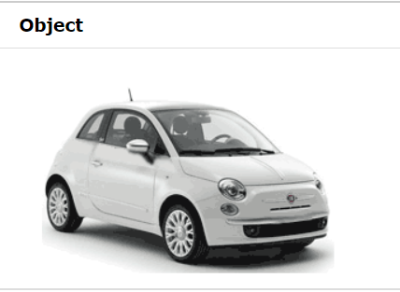
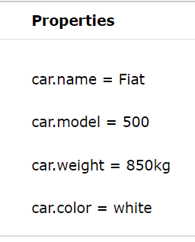
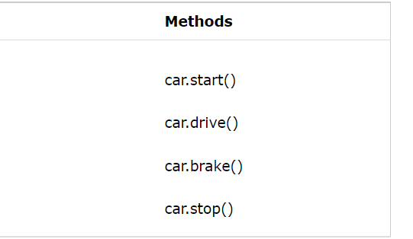
JavaScript Objects
All cars have the same properties, but the property values differ from car to car.
All cars have the same methods, but the methods are performed at different times.
Real Life Objects, Properties, and Methods
In real life, a car is an object.
A car has properties like weight and color, and methods like start and stop:

Slide 23
JavaScript Objects
All cars have the same properties, but the property values differ from car to car.
All cars have the same methods, but the methods are performed at different times.
Objects are variables too. But objects can contain many values.
This code assigns many values (Fiat, 500, white) to a variable named car:
const car = {type:"Fiat", model:"500", color:"white"};
It is a common practice to declare objects with the const keyword.
Property :value

Slide 24
Object Properties and methods
objectName.propertyName
// car.model;
objectName["propertyName"]
// person[“lastName”];
Objects can also have methods.
Methods are actions that can be performed on objects.
Methods are stored in properties as function definitions.
fullName: function(){return this.firstName + “ ” + this.lastName;}
A method is a function stored as a property.

Slide 25
The this Keyword
In a function definition, this refers to the "owner" of the function.
In the example above, this is the person object that "owns" the fullName function.
In other words, this.firstName means the firstName property of this object.
objectName.methodName()
name = person.fullName();
If you access a method without the () parentheses, it will return the function definition:
//function() { return this.firstName + " " + this.lastName; }

Slide 26
Do Not Declare Strings, Numbers, and Booleans as Objects!
When a JavaScript variable is declared with the keyword "new", the variable is created as an object:
x = new String(); // Declares x as a String object y = new Number(); // Declares y as a Number object z = new Boolean(); // Declares z as a Boolean object
Avoid String, Number, and Boolean objects. They complicate your code and slow down execution speed.

